Slide 1
Detecting Parkinson's Disease with Machine Learning

Slide 2
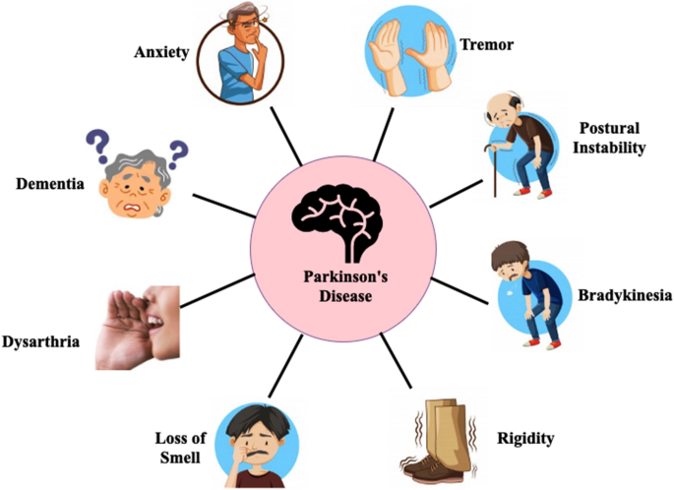
Introduction
Parkinson's disease is a neurodegenerative disorder that affects millions of people worldwide. It is characterized by tremors, stiffness, and difficulty with movement. The disease can have a significant impact on a person's quality of life, and there is currently no cure.
In this presentation, we will explore how machine learning can be used to improve Parkinson's disease diagnosis. By analyzing large amounts of data, machine learning algorithms can identify patterns and make accurate predictions about whether someone has the disease. This has the potential to revolutionize the way Parkinson's disease is diagnosed and treated.

Slide 3
The Challenge of Diagnosis
Diagnosing Parkinson's disease can be challenging, as symptoms can vary widely between individuals and may not appear until the disease has progressed significantly. Current diagnostic methods, such as clinical assessments and imaging tests, also have limitations and may not provide a definitive diagnosis.
For example, clinical assessments rely on subjective observations by healthcare professionals and may miss early or mild symptoms. Imaging tests, such as MRI and PET scans, can detect changes in the brain associated with Parkinson's disease but are expensive and not widely available. As a result, many people with Parkinson's disease may go undiagnosed or misdiagnosed for years.

Slide 4
Machine Learning and Parkinson's Disease
Machine learning is a type of artificial intelligence that allows computers to learn from data without being explicitly programmed. In the context of Parkinson's disease, machine learning algorithms can be trained on large datasets of patient information to identify patterns and make accurate predictions about who has the disease.
For example, machine learning can analyze data from clinical assessments, imaging tests, and other sources to identify common features or biomarkers associated with Parkinson's disease. These biomarkers can then be used to develop diagnostic tools that are more accurate and efficient than current methods.

Slide 5
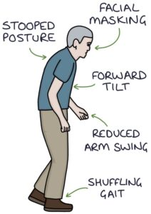
Significance of Early Detection of Parkinson’s Disease
Timely treatment can be initiated, helping manage symptoms and slowing down disease progression.
Early detection allows for proactive monitoring and adjustment of treatment plans, leading to better patient outcomes.
Intervention in the early stages may delay or mitigate the onset of motor symptoms associated with Parkinson's disease.
Early diagnosis provides access to support groups, educational resources, and specialized care services.
Non-motor symptoms can be identified and managed more effectively, improving overall quality of life.
Early detection contributes to research efforts and the development of novel therapies.
Diagnosing Parkinson's disease requires a comprehensive evaluation by a healthcare professional with expertise in movement disorders.

Slide 6
Data Collection
Data collection is a crucial step in using machine learning for Parkinson's disease diagnosis. The more data that is available, the more accurate and reliable the machine learning models will be.
There are several types of data that can be used for machine learning, including clinical assessments, imaging tests, genetic data, and wearable sensor data. Each type of data provides different insights into the disease and can be used to develop more comprehensive diagnostic tools.

Slide 7
Feature Extraction
Feature extraction is the process of identifying relevant features or biomarkers in the data that can be used to make predictions about whether someone has Parkinson's disease. This involves analyzing the data to identify patterns or correlations that are associated with the disease.
For example, feature extraction can identify changes in brain activity, movement patterns, or genetic markers that are more common in people with Parkinson's disease than in healthy individuals. These features can then be used to train machine learning models to make accurate predictions about whether someone has the disease.

Slide 8
Model Training
Model training is the process of using the data to train machine learning algorithms to make accurate predictions about Parkinson's disease. There are several types of machine learning models that can be used for this purpose, including decision trees, neural networks, and support vector machines.
Each type of model has its own strengths and weaknesses, and the choice of model depends on the specific data and research question. Once the model is trained, it can be tested on new data to evaluate its accuracy and performance.

Slide 9
Model Evaluation
Model evaluation is the process of testing the accuracy and performance of machine learning models for Parkinson's disease diagnosis. There are several metrics that can be used to evaluate models, including sensitivity, specificity, and area under the curve.
For example, sensitivity measures how well the model can correctly identify people with Parkinson's disease, while specificity measures how well the model can correctly identify people without the disease. The area under the curve provides an overall measure of the model's accuracy.

Slide 10
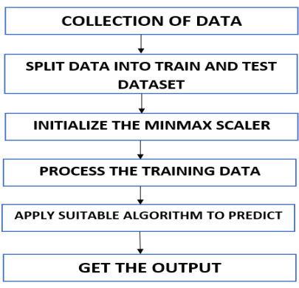
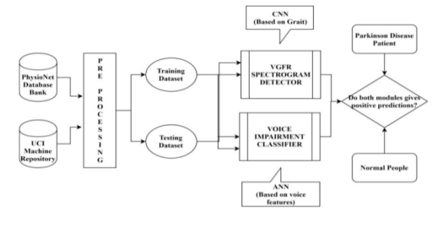
Dataflow Diagram

Slide 11
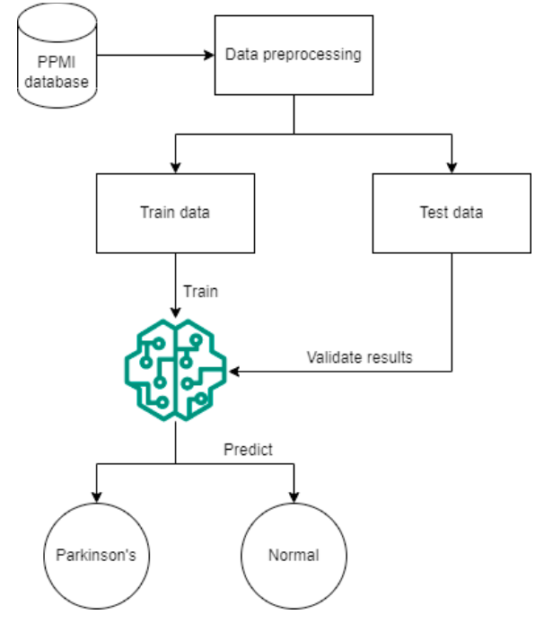
Proposed Architecture

Slide 12
Future Directions
Machine learning has the potential to revolutionize Parkinson's disease diagnosis and treatment. In the future, machine learning models could be used to develop personalized treatment plans based on individual patient characteristics and disease progression.
Additionally, machine learning could be used to identify new biomarkers or targets for drug development, leading to more effective treatments and potentially a cure for Parkinson's disease.

Slide 13
Challenges and Limitations
While machine learning shows great promise for Parkinson's disease diagnosis, there are also several challenges and limitations to consider. One challenge is the need for large amounts of high-quality data to train the models.
Another challenge is the potential for bias in the data or models, which could lead to inaccurate or unfair predictions. Additionally, machine learning models may not be able to capture the full complexity of Parkinson's disease and may not be suitable for all patients.

Slide 14
Ethical Considerations
As with any new technology, there are also ethical considerations to take into account when using machine learning for Parkinson's disease diagnosis. One important consideration is the need for transparency and accountability in the development and use of these tools.
Patients and healthcare professionals should be informed about how the models work, what data is being used, and how the predictions are made. Additionally, safeguards should be put in place to prevent misuse or discrimination based on the predictions.

Slide 15
Results
The results of machine learning models for Parkinson's disease diagnosis have been promising. Studies have shown that machine learning can accurately predict whether someone has the disease with high sensitivity and specificity.
For example, one study found that a machine learning algorithm trained on clinical assessments and imaging tests could predict Parkinson's disease with 95% accuracy. This is much higher than current diagnostic methods and has the potential to improve early detection and treatment of the disease.

Slide 16
Conclusion
In conclusion, machine learning has the potential to improve Parkinson's disease diagnosis and treatment by analyzing large amounts of data and identifying patterns that may not be apparent to healthcare professionals. While there are challenges and limitations to consider, the results so far have been promising.
By continuing to develop and refine machine learning models for Parkinson's disease diagnosis, we can improve early detection and treatment of the disease and ultimately improve the lives of millions of people worldwide.

Slide 17
References
1. Postuma RB, Berg D, Stern M, et al. MDS clinical diagnostic criteria for Parkinson's disease. Mov Disord. 2015;30(12):1591-1601.
2. Fahn S. Description of Parkinson's disease as a clinical syndrome. Ann N Y Acad Sci. 2003;991:1-14.
3. Litvan I, Bhatia KP, Burn DJ, et al. Movement Disorders Society Scientific Issues Committee report: SIC Task Force appraisal of clinical diagnostic criteria for Parkinsonian disorders. Mov Disord. 2003;18(5):467-486.

Slide 18
Thank You

